Slide 1
Forecasting Bike Rental Demand in SF
Data Science capstone project
Rui cao

Slide 2
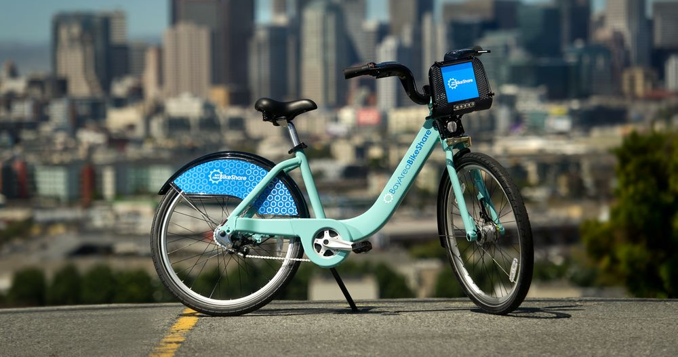
Introduction
Commonly used on metropolitan cities
500 bike sharing system worldwide
SF lunched in 2013, 70 stations until 2015
Cities: bike redistribution between stations and future bike station installation
Users: Is the bike available at my nearest station?

Slide 3
Objective
Data : SF Bay Area Bike Share dataset
Data Wrangling
Data Exploratory Analysis - Evaluates current ridership trends
Machine learning – predicted daily trip counts for the San Francisco bike share system
Feature Engineering

Slide 4
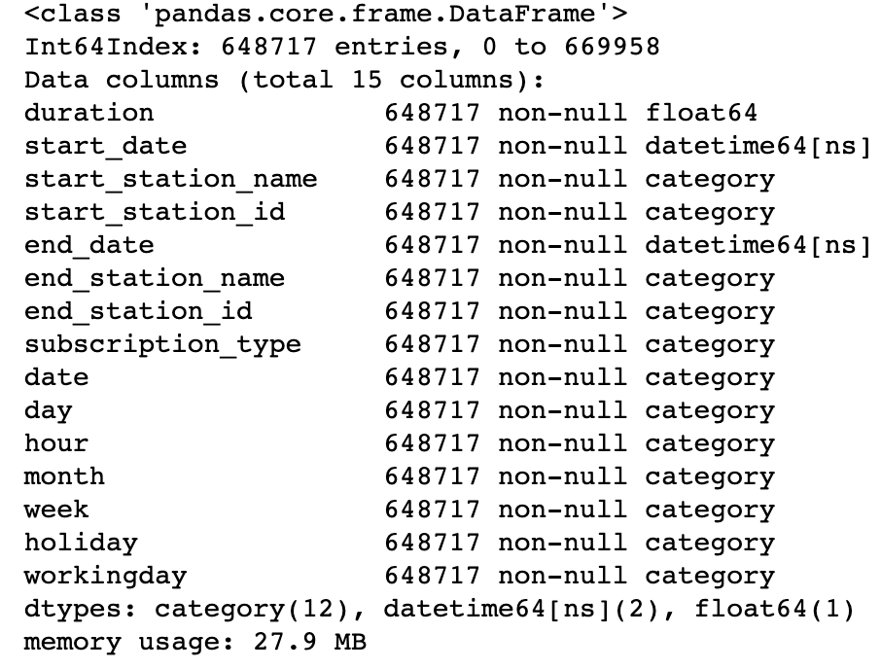
Data Wrangling - Trip
11 columns and 648717 entries trip-level records
Check null values
Remove duration outliers
Add new columns
Convert columns datatype

Slide 5
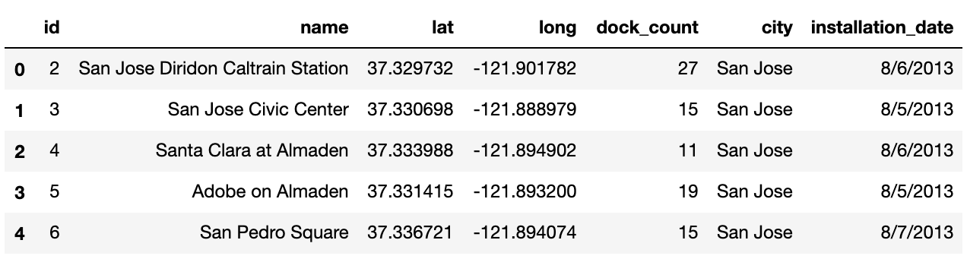
Data Wrangling - Station
Metadata for 70 stations
No missing values
Convert data type to category
Convert installation date to datetime

Slide 6
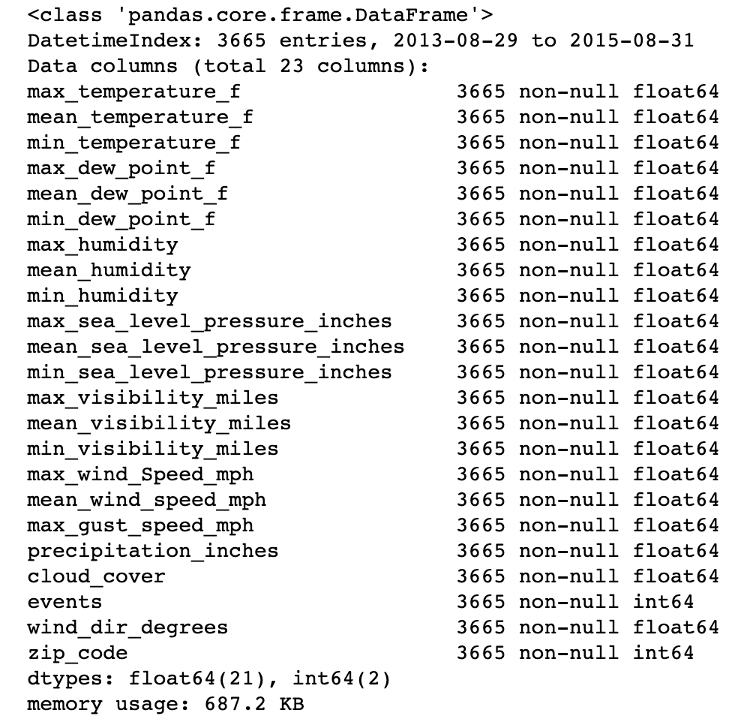
Data Wrangling – Weather
zip-level daily weather patterns for the SF Bay Area
Fill events null values with ‘Normal’
Fill numerical values with own average
map the 5 zip codes with the corresponding city name
Add new column, drop zip code column

Slide 7
Merging data
Trip - group by date, station name, holiday, weekday to get the trip count on each day by each station
Left merge station on station name
Fill missing values
Left merge weather on city and date
Check columns datatype

Slide 8
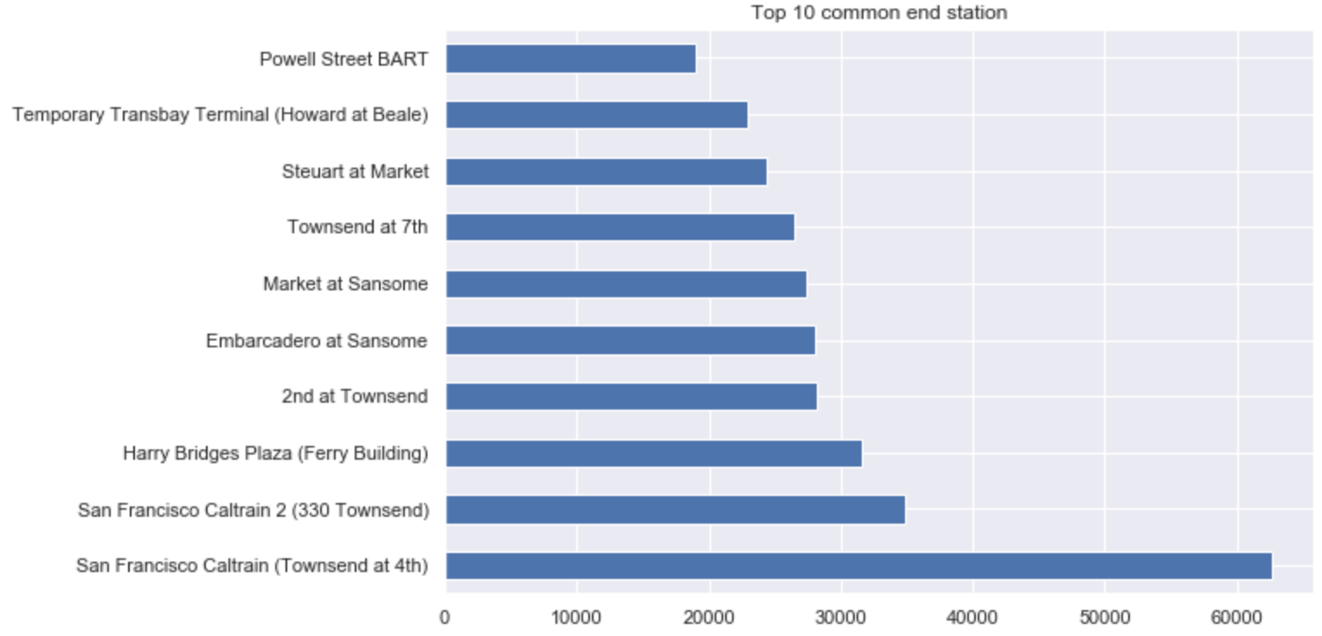
Exploratory Data Analysis
Most common station –
San Francisco Caltrain

Slide 9
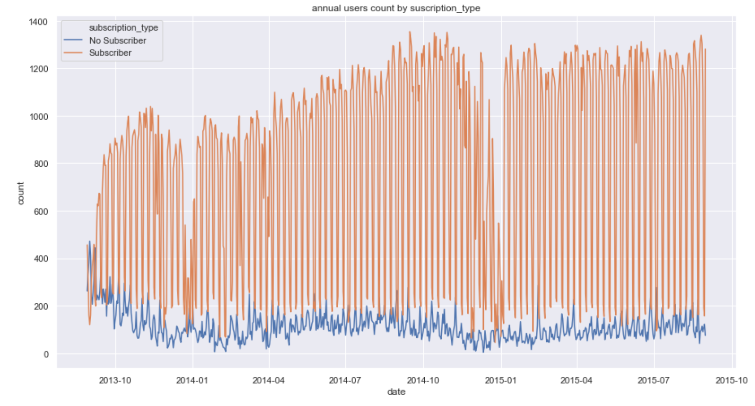
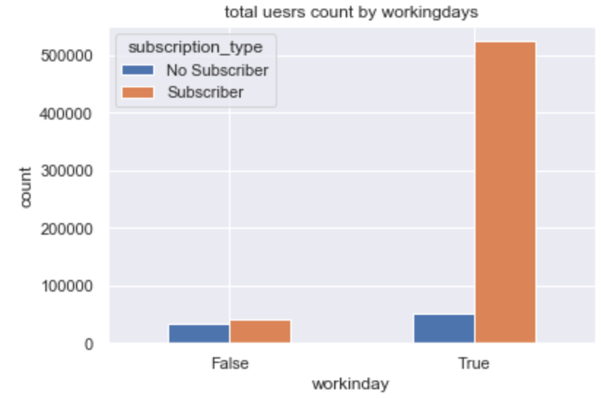
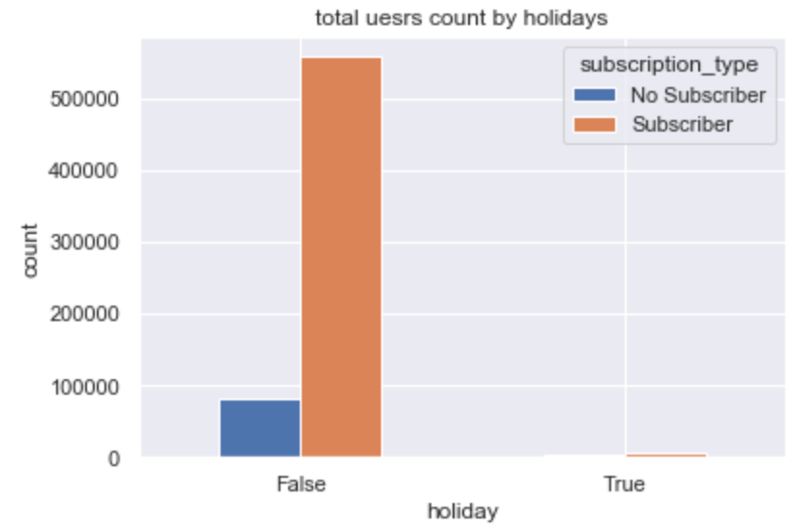
Exploratory Data Analysis
distinct patterns for Subscribers vs. No Subscribers
Subscribers are commuters and No Subscribers are largely tourists.
Subscriber ridership has a large drop on holidays and weekends

Slide 10
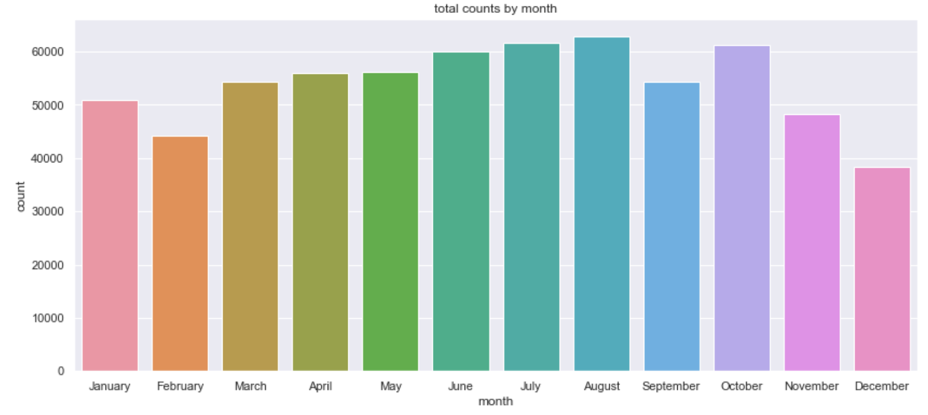
Exploratory Data Analysis
ridership increases slightly in the first half of the year
peaking in summer (week 34/35) in ideal bike weather
start to drop off in the Fall.
big drop on December

Slide 11
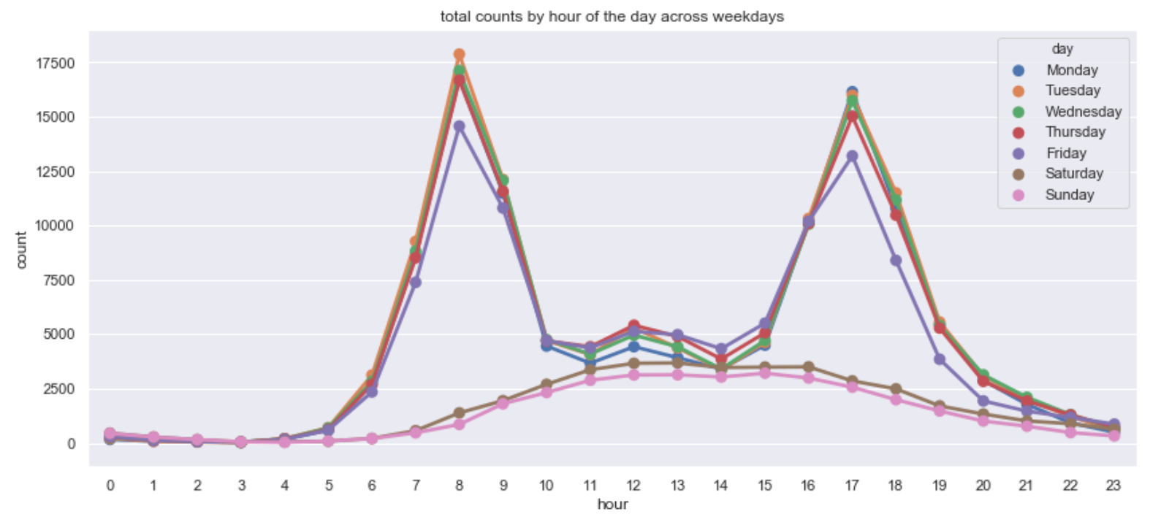
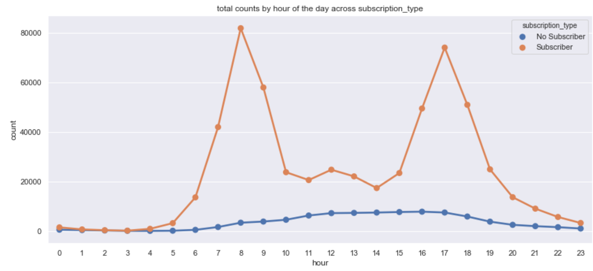
Exploratory Data Analysis
Subscriber - a distinct bi-modal daily usage pattern,
Subscriber - peaks during AM & PM commute hours, and a small increase during lunch.
No subscriber - gets a later start (as one does on vacation), with steady usage 11am until the early evening

Slide 12
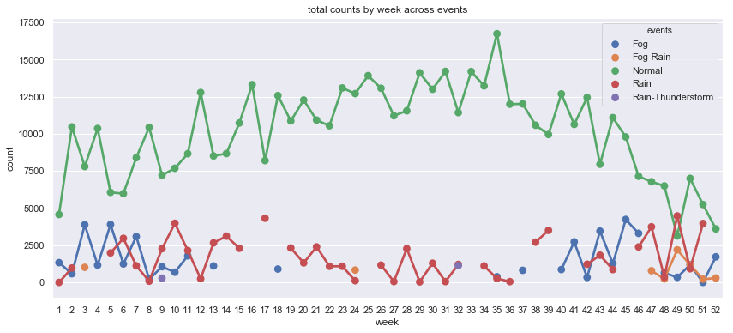
Exploratory Data Analysis
No clear relationships between weather and trip counts
people are willing to use a bike rental service on a normal day rather than fog or raining day
The trip counts have no significant difference between fog and rain
more fog weather in wintertime them summer.

Slide 13

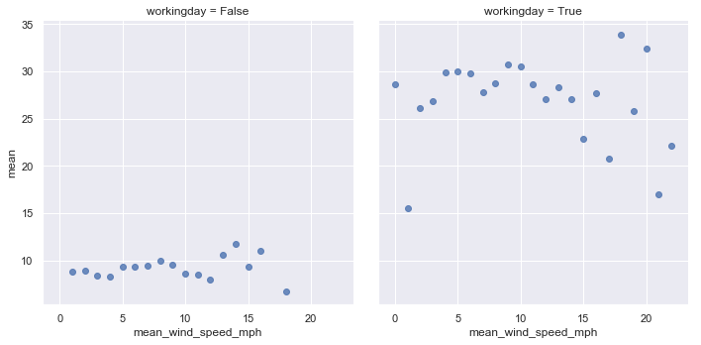
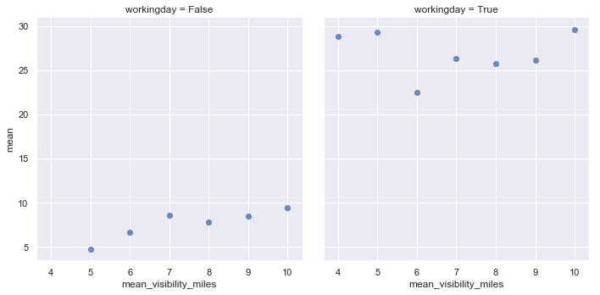
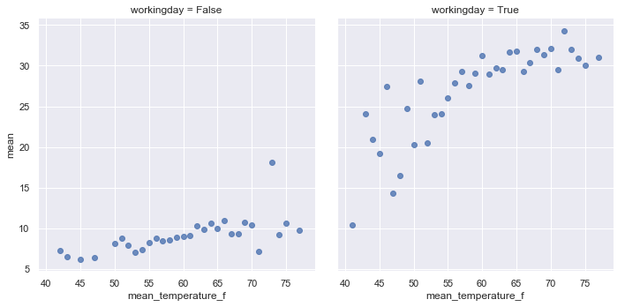
Exploratory Data Analysis

Slide 14
Machine Learning
Daily trip count prediction
Station - San Francisco Caltrain (Townsend at 4th)
Regression model
Metric – Mean Absolute Error
Hyperparameter Tuning

Slide 15
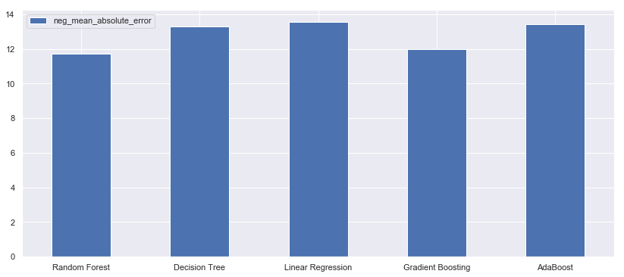
Machine Learning
Random Forest has the smallest MAE of 11.69

Slide 16
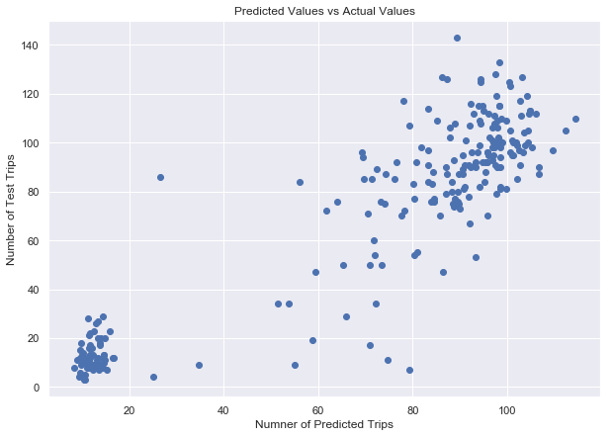
Machine Learning

Slide 17
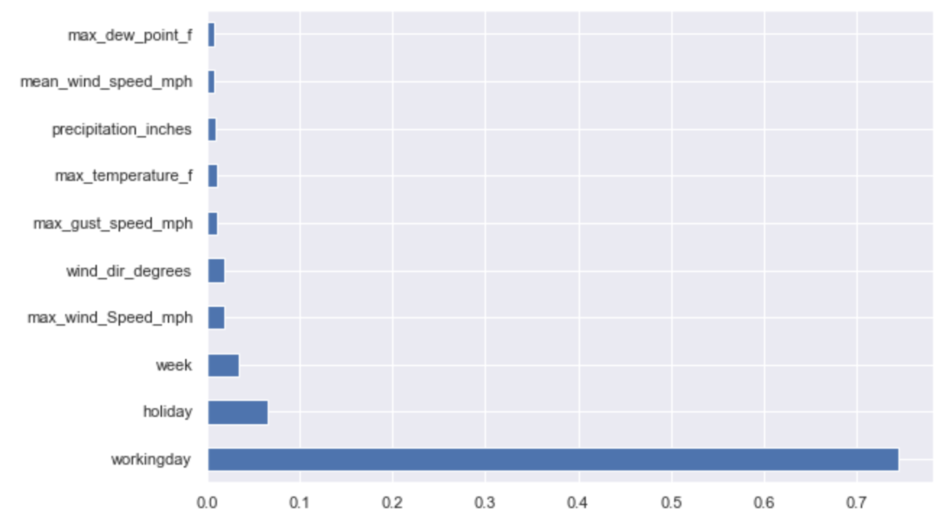
Feature Engineering

Slide 18
Conclusion
Regression model with 11 trips per day mean absolute error
Next Step
Focus on large number of trips (60-80)
Optimize the model
Ensemble Learning
Hyperparameter Tuning

